Slide 1
Mathematical Foundations for Data Science
MFDS Team

Slide 2
DSECL ZC416, MFDS
Lecture 0

Slide 3
Agenda
Matrices and their types
REF and RREF
Rank, its computation and properties
Determinant, its computation and properties
Consistency and inconsistency of linear systems
Modeling using linear equations
Vector and matrix norms

Slide 4
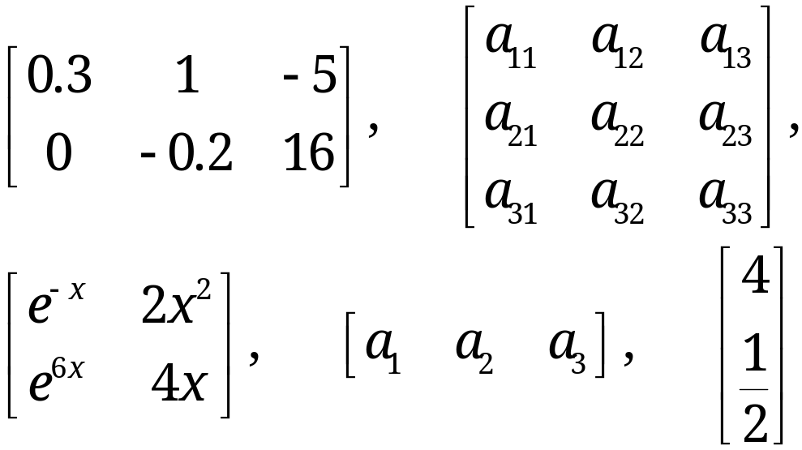
Matrices
A matrix is a rectangular array of numbers or functions which we will enclose in brackets. For example,
(1)
The numbers (or functions) are called entries or, less commonly, elements of the matrix.
The first matrix in (1) has two rows, which are the horizontal lines of entries.

Slide 5
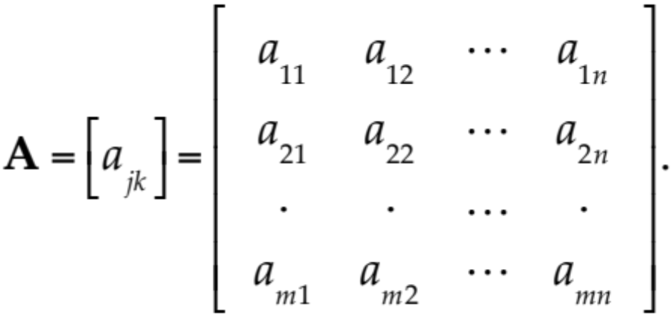
Matrix – Notations
We shall denote matrices by capital boldface letters A, B, C, … , or by writing the general entry in brackets; thus A = [a_{jk}], and so on.
By an m × n matrix (read m by n matrix) we mean a matrix with m rows and n columns—rows always come first! m × n is called the size of the matrix. Thus an m × n matrix is of the form
(2)

Slide 6
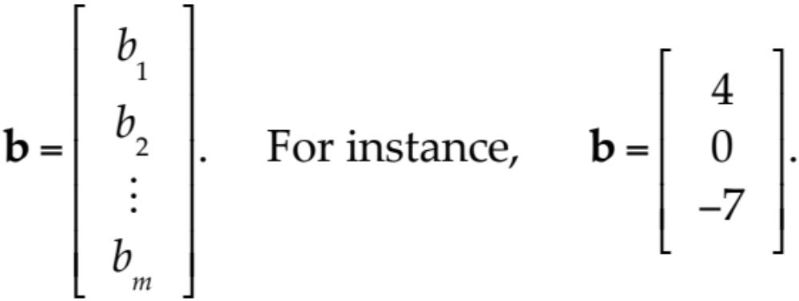
Vectors
A vector is a matrix with only one row or column. Its entries are called the components of the vector.
We shall denote vectors by lowercase boldface letters a, b, … or by its general component in brackets, a = [a_{j}], and so on. Our special vectors in (1) suggest that a (general) row vector is of the form
A column vector

Slide 7
Equality of Matrices
Two matrices A = [a_{jk}] and B = [b_{jk}] are equal, written A = B, if and only if (1) they have the same size and (2) the corresponding entries are equal, that is, a₁₁ = b₁₁, a₁₂ = b₁₂, and so on.
Matrices that are not equal are called different. Thus, matrices of different sizes are always different.

Slide 8
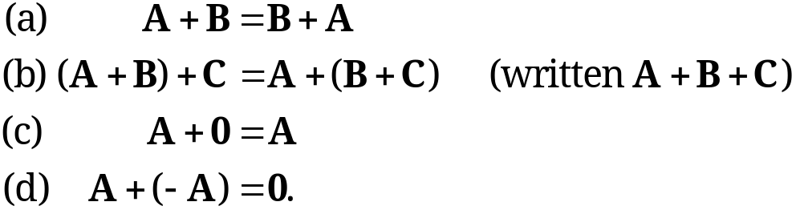
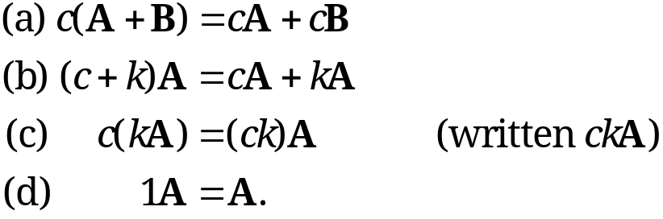
Algebra of Matrices
1. Addition of Matrices
The sum of two matrices A = [a_{jk}] and B = [b_{jk}] of the same size is written A + B and has the entries a_{jk} + b_{jk} obtained by adding the corresponding entries of A and B. Matrices of different sizes cannot be added.
2. Scalar Multiplication (Multiplication by a Number)
The product of any m × n matrix A = [a_{jk}] and any scalar c (number c) is written cA and is the m × n matrix cA = [ca_{jk}] obtained by multiplying each entry of A by c.
Here 0 denotes the zero matrix (of size m × n), that is, the m × n matrix with all entries zero.

Slide 9
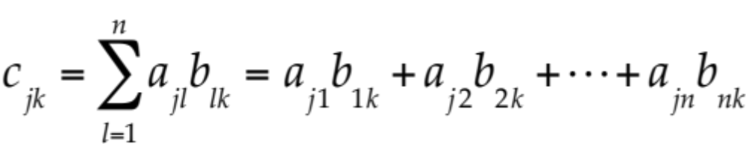
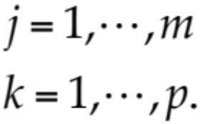
Matrix Multiplication
Multiplication of a Matrix by a Matrix
The product C = AB (in this order) of an m × n matrix A = [a_{jk}] times an r × p matrix B = [b_{jk}] is defined if and only if r = n and is then the m × p matrix C = [c_{jk}] with entries
(3)
The condition r = n means that the second factor, B, must have as many rows as the first factor has columns, namely n. A diagram of sizes that shows when matrix multiplication is possible is as follows:
A B = C
[m × n] [n × p] = [m × p].

Slide 10
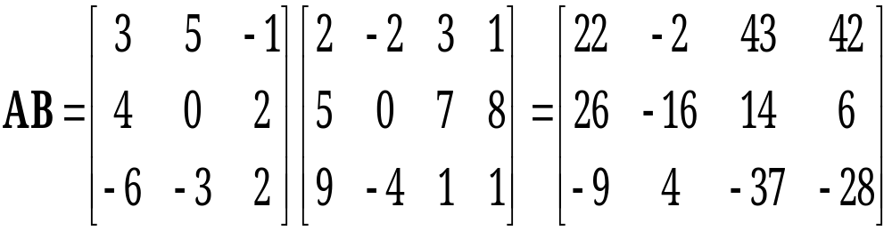
Matrix Multiplication
EXAMPLE 1
Here c₁₁ = 3 · 2 + 5 · 5 + (−1) · 9 = 22, and so on. The entry in the box is c₂₃ = 4 · 3 + 0 · 7 + 2 · 1 = 14.
The product BA is not defined.

Slide 11
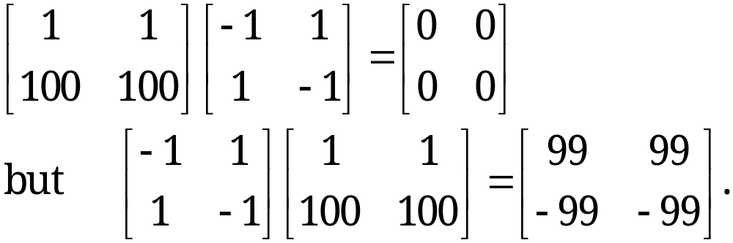
Matrix Multiplication
Matrix Multiplication Is Not Commutative, AB ≠ BA in General
This is illustrated by Example 1, where one of the two products is not even defined. But it also holds for square matrices. For instance,
It is interesting that this also shows that AB = 0 does not necessarily imply BA = 0 or A = 0 or B = 0.

Slide 12
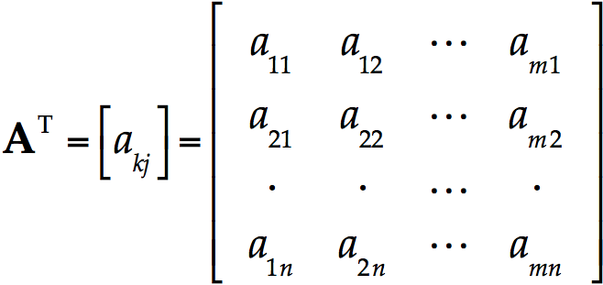
Transposition of Matrices & Vectors
The transpose of an m × n matrix A = [a_{jk}] is the n × m matrix A^{T} (read A transpose) that has the first row of A as its first column, the second row of A as its second column, and so on. Thus the transpose of A in (2) is A^{T} = [a_{kj}], written out
(4)
As a special case, transposition converts row vectors to column vectors and conversely.
Notes:
Dimensions of A^{T} are the reverse of dimension of A

Slide 13
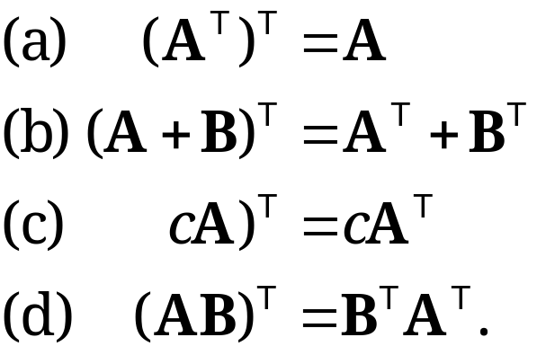
Transposition of Matrices
Rules for transposition are
(5)
CAUTION! Note that in (5d) the transposed matrices are in reversed order.
(

Slide 14
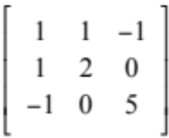
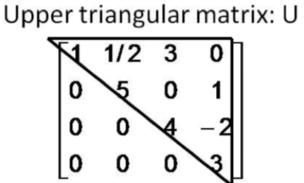
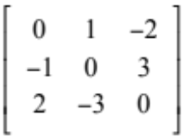
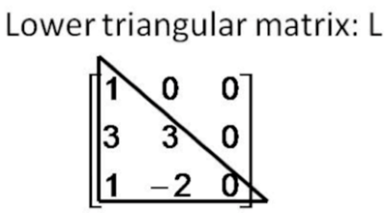
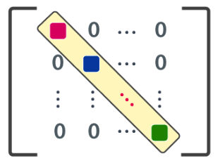
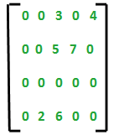
Special Matrices
Symmetric: a_{ij} = a_{ji} Eg:
Skew Symmetric : a_{ij} = - a_{ji} Eg:
Triangular: Upper Triangular → a_{ij} = 0 for all i > j
Lower Triangular → a_{ij} = 0 for all i < j
Diagonal Matrix: a_{ij} = 0 for all i ≠ j Eg:
Sparse Matrix: Many zeroes and few non-zero entities
Orthogonal matrix: A such that A^{T} = A⁻¹
Notes:
Symmetric : A^{T} = A
Skew Symmetric A^{T} = - A

Slide 15
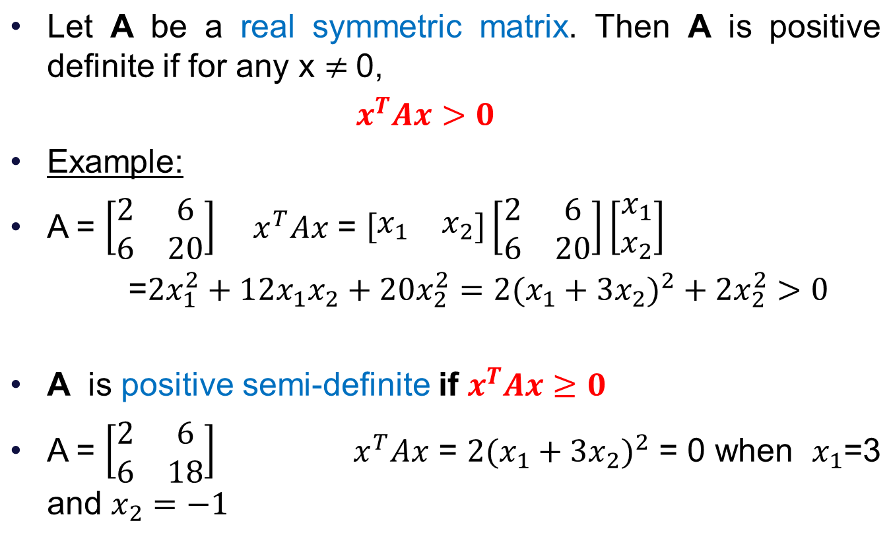
Positive Definite matrix

Slide 16
Elementary Row Operations
Interchange of two rows
Addition of a constant multiple of one row to another row
Multiplication of a row by a nonzero constant c
CAUTION! These operations are for rows, not for columns!

Slide 17
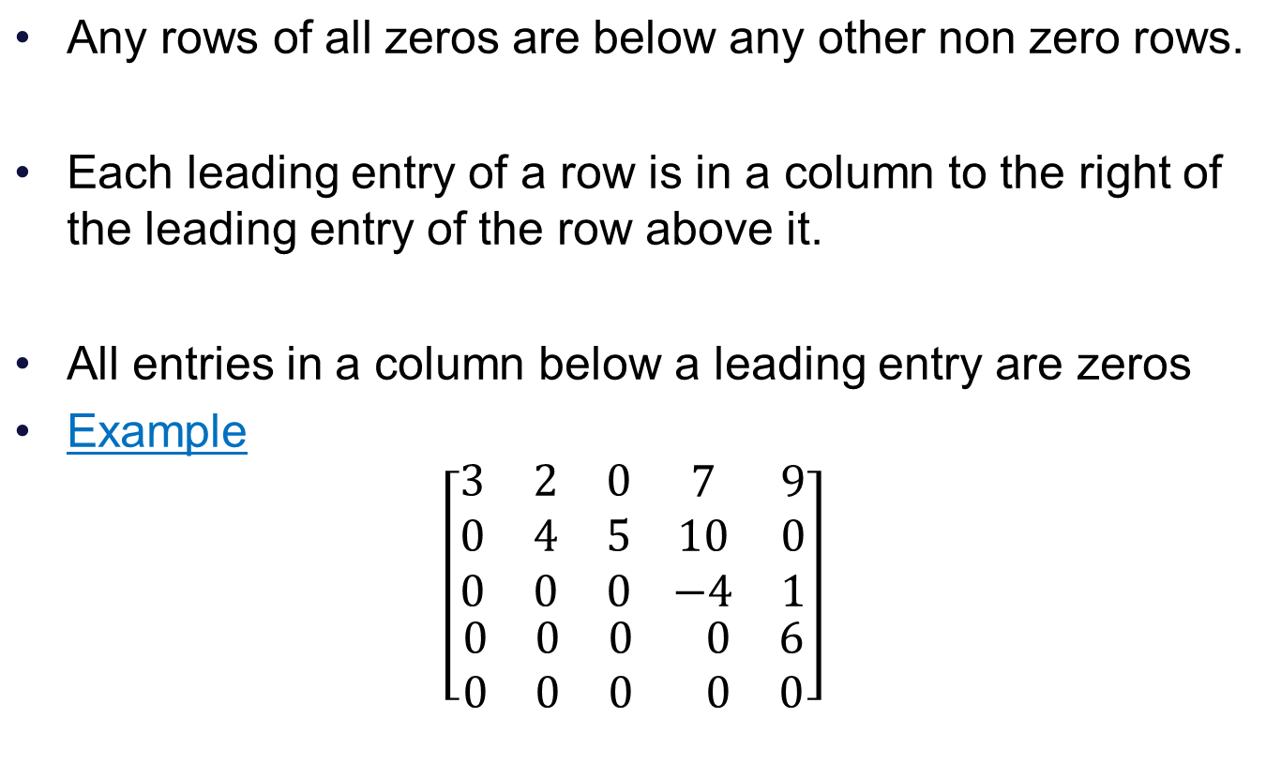
Row Echelon Form (REF) of a matrix

Slide 18

Row Reduced Echelon Form (RREF)
We say that a matrix is in Reduced Row Echelon Form if it is in Echelon form and additionally,
1. The leading entry in each row is 1.
2. Each leading 1 is the only non zero entry in its column

Slide 19
Uniqueness of Row Reduced Echelon Form
We can transform any matrix into a matrix in reduced echelon form by using elementary row operations.
No matter what sequence of row operations we use each matrix is row equivalent to one and only one reduced echelon matrix

Slide 20
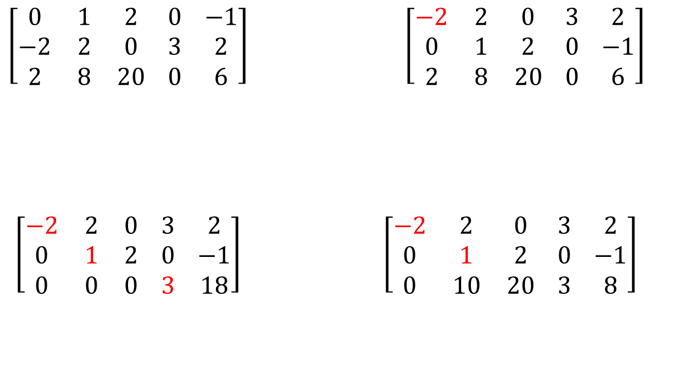
Row-reduction of a Matrix
Swap rows 1 and 2
Replace R3 by R3+1.R1
Replace R3 by R3+(-10).R2
Row Echelon Form

Slide 21
Rank of a Matrix
Definition
The rank of a matrix A is the maximum number of linearly independent row vectors of A.
It is denoted by rank A.
We call a matrix A₁ row-equivalent to a matrix A₂ if A₁ can be obtained from A₂ by (finitely many!) elementary row operations.
Theorem 1
Row-equivalent matrices have the same rank.

Slide 22
Rank vs row operations
Now the maximum number of linearly independent row vectors of a matrix does not change if we change the order of rows or multiply a row by a nonzero c or take a linear combination by adding a multiple of a row to another row.
This shows that rank is invariant under elementary row operations:
The number of nonzero rows, r, in the row-reduced coefficient matrix R is called the rank of R and also the rank of A.

Slide 23
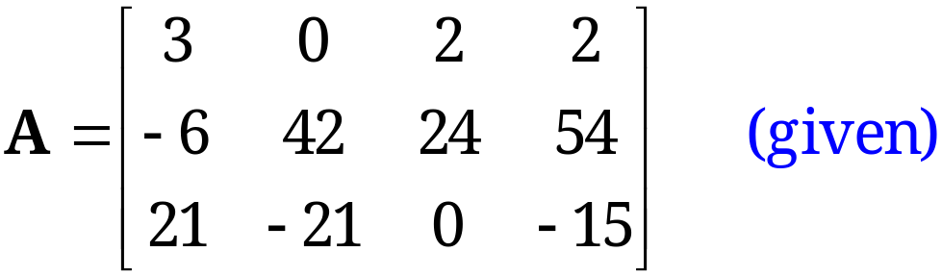
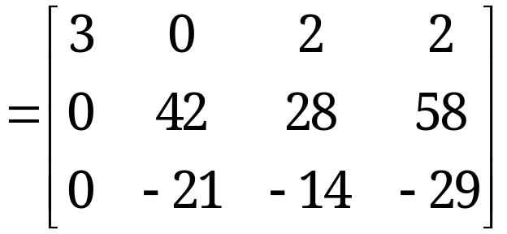

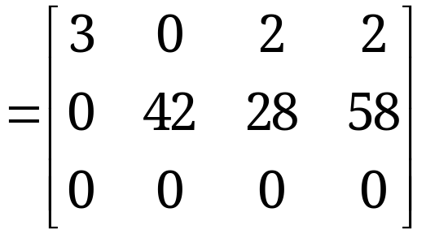

Determination of Rank
The last matrix is in row-echelon form and has two nonzero rows. Hence rank A = 2.

Slide 24
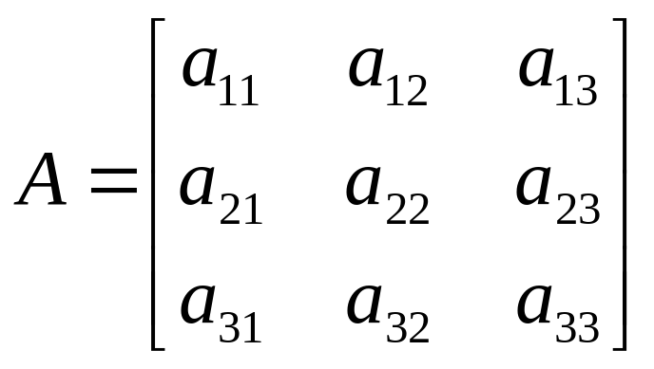
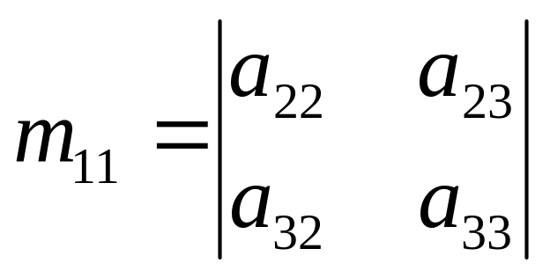
Minor
Each element in A has a minor
Delete first row and column from A .
The determinant of the remaining 2 x 2 submatrix is the minor of a₁₁

Slide 25

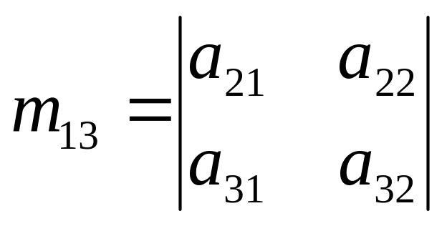
Minor
And the minor for a₁₃ is:

Slide 26
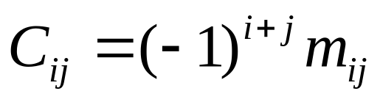
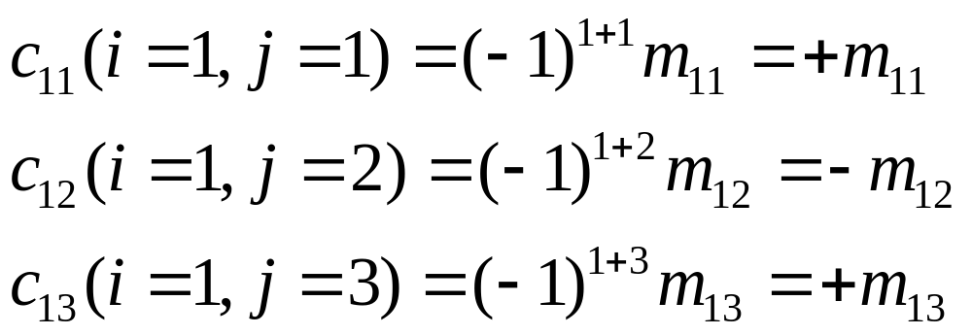
Cofactor
The cofactor C_{ij} of an element a_{ij} is defined as:
When the sum of a row number i and column j is even, c_{ij} = m_{ij} and when i+j is odd, c_{ij} =-m_{ij}

Slide 27
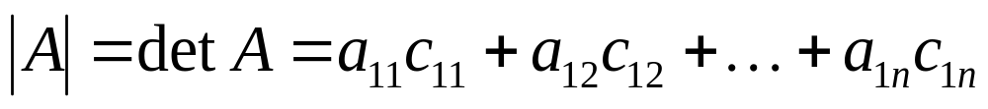
Determinant
The determinant of an n x n matrix A can now be defined as
The determinant of A is therefore the sum of the products of the elements of the first row of A and their corresponding cofactors.
(It is possible to define |A| in terms of any other row or column but for simplicity, the first row only is used)

Slide 28
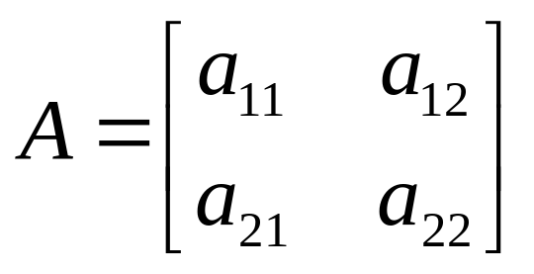
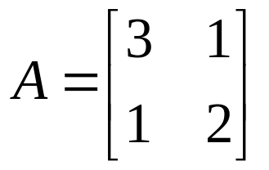
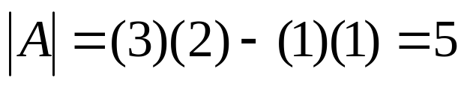
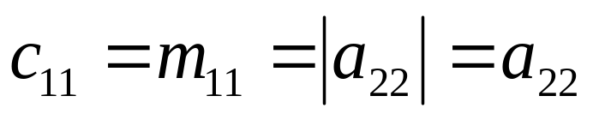
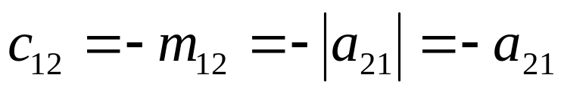
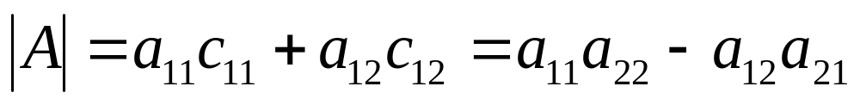
Determinant -Example
Therefore the 2 x 2 matrix :
Example 1:
Has cofactors :
And:
And the determinant of A is:

Slide 29

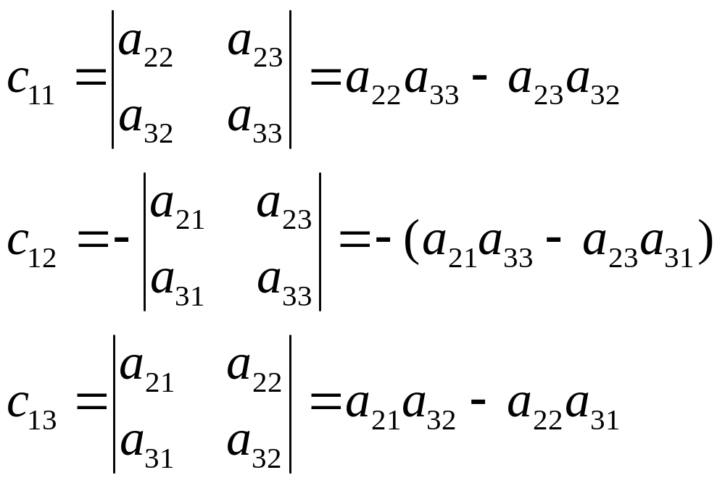
Determinant -Example
The cofactors of the first row are:

Slide 30
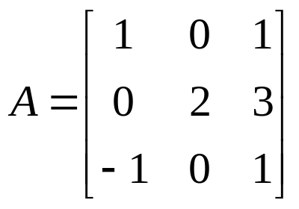
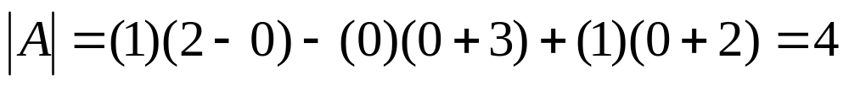
Matrices - Operations
Which by substituting for the cofactors in this case is:
Example 2:

Slide 31
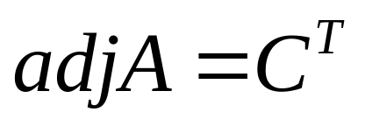
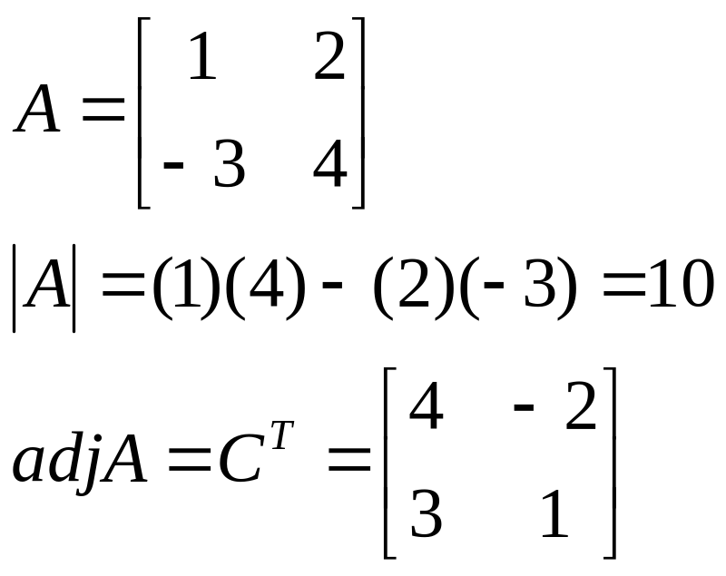
Adjoint
The adjoint matrix of A, denoted by adj A, is the transpose of its cofactor matrix
It can be shown that:
A(adj A) = (adjA) A = |A| I
Example:

Slide 32
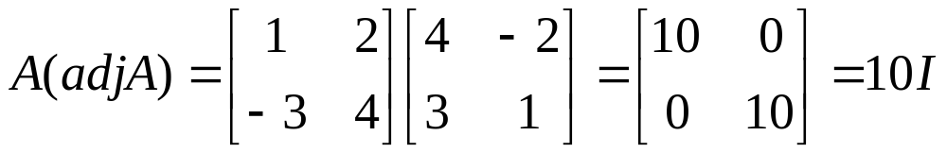
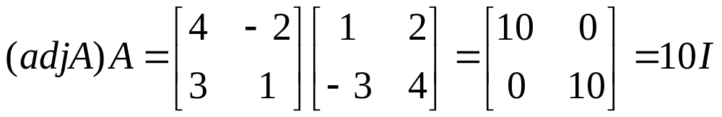
Adjoint

Slide 33
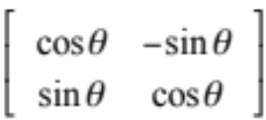
Properties of Determinants
det(AB) =det(A) * det (B)
det(A) nonzero implies there exists a matrix B such that AB=BA=I
Two Rows Equal➔ det = 0(Singular)
R_{i} and R_{j} swapped ➔ det gets a minus sign (i ≠ j)
det(A) = det(A^{T})
R_{i} ← cR_{j} ➔det A ←c detA
Orthogonal matrices: det(A) = -1 or 1
Notes:
6.Multiplication of a row by c multiplies the value of determinant by c

Slide 34
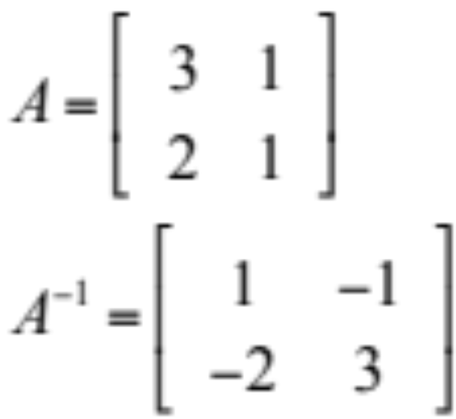
Inverse
A⁻¹ = adj(A) where det(A) ≠ 0
det(A)
Reiterate det(A) ≠ 0 → A is Non singular

Slide 35
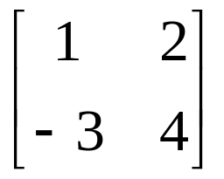
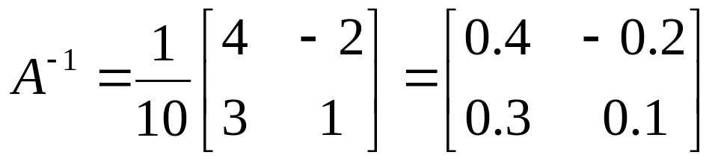
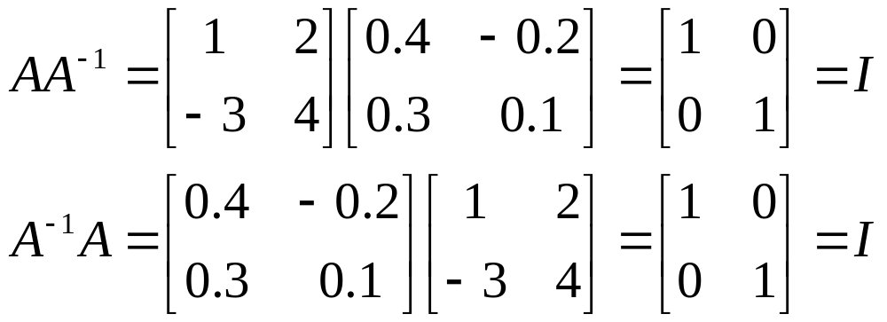
Inverse – 2x2 Example
Example
A =
To check
AA⁻¹ = A⁻¹ A = I

Slide 36
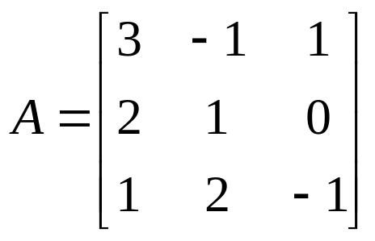
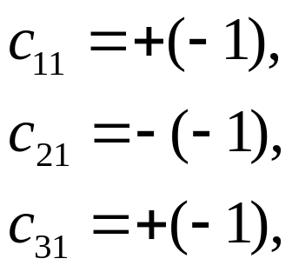
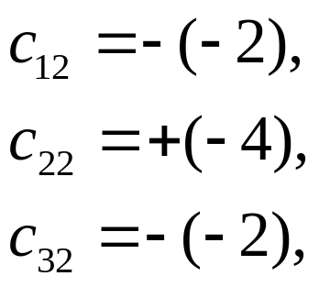

Inverse – 3x3 Example
Example 2
The determinant of A is
|A| = (3)(-1-0)-(-1)(-2-0)+(1)(4-1) = -2
The elements of the cofactor matrix are

Slide 37



Inverse – 3x3 Example
The cofactor matrix is therefore
so
and

Slide 38
Inverse
The result can be checked using
AA⁻¹ = A⁻¹ A = I
The determinant of a matrix must not be zero for the inverse to exist as there will not be a solution
Nonsingular matrices have non-zero determinants
Singular matrices have zero determinants

Slide 39


Inverse -Simple 2 x 2 case
So that for a 2 x 2 matrix the inverse can be constructed in a simple fashion as
Exchange elements of main diagonal
Change sign in elements off main diagonal
Divide resulting matrix by the determinant

Slide 40


Inverse -Simple 2 x 2 case
Example
Check inverse
A⁻¹ A=I

Slide 41

Linear System
A linear system of m equations in n unknowns x₁, … , x_{n} is a set of equations of the form
(1)
The system is called linear because each variable x_{j} appears in the first power only, just as in the equation of a straight line.

Slide 42
Linear System
(1)
a₁₁, … , a_{mn} are given numbers, called the coefficients of the system.
b₁, … , b_{m} on the right are also given numbers.
If all the bj are zero, then (1) is called a homogeneous system.
If at least one bj is not zero, then (1) is called a non-homogeneous system.

Slide 43

Coefficient Matrix
Matrix Form of the Linear System (1).
From the definition of matrix multiplication we see that the m equations of (1) may be written as a single vector equation
Ax = b (2)
where the coefficient matrix A = [a_{jk}] is the m × n matrix
are column vectors.

Slide 44

Matrix Form of Linear System
Matrix Form of the Linear System (1). (continued)
We assume that the coefficients a_{jk} are not all zero, so that A is not a zero matrix. Note that x has n components, whereas b has m components. The matrix
is called the augmented matrix of the system (1).
The dashed vertical line could be omitted, as we shall do later. It is merely a reminder that the last column of Ã did not come from matrix A but came from vector b. Thus, we augmented the matrix A.

Slide 45
Solution to System of Linear Equations
A linear system (1) is called overdetermined if it has more equations than unknowns, determined if m = n, and underdetermined if it has fewer equations than unknowns.
A linear system is consistent if rank(A) = rank(A|b)
A consistent system has at least one solution (thus, one solution or infinitely many solutions), but inconsistent has no solutions at all, as x₁ + x₂ = 1, x₁ + x₂ = 0.

Slide 46
Solution
The method for determining whether Ax = b has solutions and what they are:
(a) No solution. If r is less than m (meaning that R actually has at least one row of all 0s) and at least one of the numbers f_{r+1}, f_{r+2}, … , f_{m} is not zero, then the system Rx = f is inconsistent: No solution is possible. Therefore the system Ax = b is inconsistent as well.

Slide 47
Solution
If the system is consistent (either r = m, or r < m and all the numbers f_{r+1}, f_{r+2}, … , f_{m} are zero), then there are solutions.
(b) Unique solution. If the system is consistent and r = n, there is exactly one solution, which can be found by back substitution.
(c) Infinitely many solutions. To obtain any of these solutions, choose values of x_{r+1}, … , x_{n} arbitrarily. Then solve the rth equation for x_{r} (in terms of those arbitrary values), then the (r − 1)st equation for x_{r−1}, and so on up the line.

Slide 48




Traffic Flow Problem
Traffic Flow
x₁ + x₄ = 1500
x₁ + x₂ = 1300
x₂ + x₃ = 1800
x₃ + x₄ = 2000
After Elementary Row Operations
Underdetermined System: Three Linear equations and Four Unknowns
Infinitely Many solutions

Slide 49

Vector Norms

Slide 50

Common norms

Slide 51

Equivalence of norms

Slide 52


Matrix Norms
Some of the commonly used matrix norms are given below

